Slide 1
Revenue
Upper 6th Micro
Revenue, Costs & Profits

Slide 2
Introduction to Revenue
Revenue
Mr O’Grady

Slide 3
Introduction to Revenue
Total Revenue (TR): The total income a firm generates from selling its output
Equation: TR=P x Q
Average revenue (AR): Revenue per unit of output
Equation: AR = TR/Q
Key Question: Why is AR = D_{(firm)}?
This relies on the assumption of uniform price (one single price is charged for all units sold)
If this the case, since TR = P x Q, we can rewrite our average revenue equation as AR = (P x Q)/Q
The Q terms cancel out and we are left with AR = P
Therefore the AR curve gives the same info as the firm’s demand curve, the price at any given quantity, AR = P = D
Marginal revenue (MR): The addition to total revenue from selling one more unit of output
Recap: Marginal refers to incremental change to one variable from an additional unit to another.
Equation: MR = ∆TR/∆Q , it is the gradient function of the TR curve!
When MR is equal to zero, total revenue is maximised
MR is a very important concept for working out how to maximise profits (more on this later)

Slide 4
Two Types of Firms
Revenue
Mr O’Grady

Slide 5
Two Types of firms
An important distinction: It is important to note that not all firms have the same shaped demand curve, and this depends on whether they have some degree of influence over the market price, or whether they simply have to take the price determined by market supply and demand.
Price Setters: A firm that can change its price to alter the quantity it sells.
Analysis Given the law of demand, a firm can lower its price in order to increase quantity demanded.
In other words, an individual price setter faces a downward sloping firm demand curve.
In order for this to happen, a firm requires some level of product differentiation – this can be as simple as producing similar (but different products) or branding (E.g. Pepsi and Coca Cola)

Slide 6
Price Setters Demand Curves:
Price
D – Coca Cola
D – Pepsi
Quantity

Slide 7
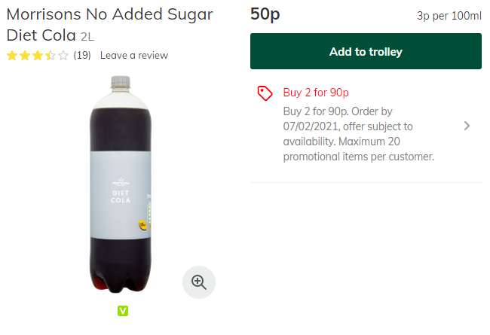
Price Takers: A firm which is unable to influence the market price and therefore must simply accept the prevailing market price.
Analysis: In this case, the market for a product (demand and supply) determines its price and individual firms in the market can sell as many units as they wish at this price.
This often happens in markets with homogeneous (identical) goods that have small market shares (E.g. Supermarket cola)
Though other conditions are required, and we will examine this in more detail later.
These firms face a perfectly elastic (flat) individual demand curve

Slide 8
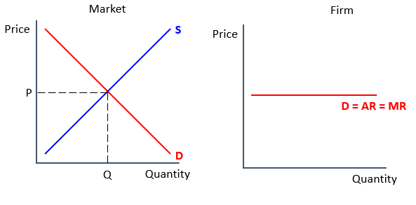
Price Takers Demand Curves:

Slide 9
Total Revenue
Revenue
Mr O’Grady

Slide 10
Total Revenue
Recap: The total income a firm gains from selling its output
Equation: TR=P x Q
Graphing total revenue – Price setters: For firms with a downward sloping demand curve, total revenue looks like this
We can see this by considering a demand curve and the TR equation
TR = P x Q is represented by the rectangular area between a point on the demand curve and the price and quantity axes
When price is high, although AR is high, TR is low as quantity is low.
After cutting price a little, revenue increases by a lot, there is a small proportional fall in price, but a large proportional increase in quantity
Cuts to price continue to increase total revenue up to the midpoint of the demand curve. This is because the proportional rise in Q outweighs the fall in AR
TR is flat at this point!
After the midpoint though, the cuts to price are detrimental to revenue. Whilst the firm is selling more, they are now priced so low that they’d do better to have a higher price and sell a bit less
Revenue
Price
TR
D
Quantity
Quantity

Slide 11
Graphing total revenue – Price takers: For firms with a flat demand curve, total revenue looks like this
This is because on the perfectly elastic demand curve, the firm doesn’t lower its price as quantity increases, so there is constant marginal revenue
Total revenue increases at the same rate regardless of the quantity
Revenue
Price
TR
D
Quantity
Quantity

Slide 12
Demand & Marginal Revenue
Revenue
Mr O’Grady

Slide 13
Demand & Marginal Revenue
Recap – Demand curve: The demand curve shows the quantity of an item that consumers are willing and able to buy at each price
Previously, demand curves studied are graphical representations of the total demand in an entire market.
But now we must consider the demand curves for individual firms, which is the same as the individual firm’s AR curve
Key Analysis: The demand curve is important in understanding marginal revenue
It shows how much a firm has to lower price in order to sell one more of an item
The steeper the demand curve is, the more a producer must lower his price in order to increase the quantity demanded, and vice versa
Assuming a uniform price total revenue is visible in a firm’s demand curve as the the rectangular area between a point on the demand curve and the price and quantity axes.
Marginal revenue can then be seen as how the area of this rectangle changes as we increase quantity incrementally
MR _{(of going from Q=1 to Q=2)} = TR₂ –TR₁
Price
TR₁
TR₂
D = AR
1
2
Quantity

Slide 14
Graphing Marginal Revenue
Marginal revenue (MR): The addition to total revenue from selling one more unit of output
Recap: Marginal refers to incremental change to one variable from an additional unit to another.
Equation: MR = ∆TR/∆Q , the gradient function of the TR curve!
Diagram: The MR curve is always below the AR curve when it is downward sloping
When a producer has to lower the price in order to sell more of an item, marginal revenue is less than price(i.e. AR), as the producer lowers the price for all the items they sell
(i.e. to increase sales to 5 units a firm has to sell the previous 4 units at a lower price; to increase sales to 6, it must cut the price of the previous 5)
Price
D = AR
MR
Quantity
N.B. In the case of straight-line demand curves, it turns out that the marginal revenue curve has the same intercept on the P axis as the demand curve but it is twice as steep, as illustrated in the diagram
Key Questions
Why does MR go below Zero?
Some sales will have a negative effect on total revenue
The gain from selling an extra is offset by the loss from cutting the price of all previous units sold
Eventually, the gain from the extra sale is outweighed by the loss from the previous sales

Slide 15
Where is total revenue maximised?
TR max occurs where MR = 0
With more output, MR is negative dragging down TR
Any less output and the firm is not making units which would add to its revenue, it is missing out on output with positive MR
The area of the rectangle between the D/AR curve and the P and Q axes is maximised
This is also the point where the demand curve is unit elastic
(Recall PED and Revenue content from elasticities topic)
Price
D = AR
What level of output would a firm produce?
In short, we don’t know enough yet!
A revenue maximising firm would produce at the point where MR = 0
However, revenue maximising isn’t the only objective for firms.
Most tend to be profit maximisers, but there are other objectives such as sales maximising
High revenues are important to find where a profit maximising firm would produce, but cost considerations are very important too
What we can determine is that any price setting profit maximising firm would produce at a quantity that is to the left of MR = 0,
It is possible to get an equal revenue from a greater level of output, but that would incur greater costs
MR
Quantity

Slide 16
Changes in Revenue
Revenue
Mr O’Grady

Slide 17
Changes in Revenue
Causes: A firms will see a change to its revenue functions should demand for the firm’s product change
Recall: The firms AR curve is simply its individual demand curve
Any factor that changes the demand for the firm’s product will shift the AR curve
E.g. a change in the price of a substitute product or a change in consumers’ real incomes
Marginal Revenue Implications: When average revenue changes, MR must shift too!
This is because the price paid for a given incremental unit (and the new price for units prior) will be different
Recall: The MR curve has the same intercept, but twice as gradient the AR curve
This relationship must be maintained after the AR has shifted
Price
D₁ = AR₁
D = AR
MR
MR₁
Quantity

Slide 18
Algebra of Marginal Revenue
Revenue +
Mr O’Grady

Slide 19
Algebra of Marginal Revenue
Marginal revenue (MR): The addition to total revenue from selling one more unit of output
Recap: Marginal refers to incremental change to one variable from an additional unit to another.
Equation: MR = ∆TR/∆Q , it is the gradient function of the TR curve!
Diagram: The marginal revenue curve is always below the demand curve when the demand curve is downward sloping
For straight-line demand curves, the marginal revenue curve has the same intercept on the P axis as the demand curve but it is twice as steep, as illustrated in the diagram
We will prove this now!
Price
D = AR
MR
Quantity

Slide 20
Proof MR is twice as steep as AR: MR is the derivative of total revenue - it tells us the change in TR from increasing Q
We can construct an MR curve by calculating TR as a function of quantity and differentiating
To calculate TR, we start by solving the demand curve for price rather than quantity (this formulation is referred to as the inverse demand curve)
Example demand function: $Q_{D}=40−5P$
Rearranging (inverse demand function): ${P=8−\frac{1}{5}Q}_{D}$
We then plug the inverse demand curve into the total revenue formula:
Total revenue formula: $TR=P×Q=\left(8−\frac{1}{5}Q\right)×Q=8Q −\frac{1}{5}Q^{2}$
MR is then calculated by taking the derivative of total revenue with respect to quantity:
Marginal revenue: $MR= \frac{dTR}{dQ}=8 − \frac{2}{5}Q$
Comparison: The (inverse) demand curve vs the Marginal Revenue curve
The coefficient on Q (gradient) is twice as large in the marginal revenue equation as it is in the demand equation, implying MR is twice as steep.
The constant (intercept) is the same in both equations, implying MR and AR start from the same point on the price axis.

Slide 21
Where next?
Don’t forget to SUBSCRIBE!
Visit our website: www.smootheconomics.co.uk
Find more resources, extension materials, details of courses, competitions, and more!
Follow our socials:
Instagram: @smootheconomics
Twitter: @SmoothEconomics
Facebook: @SmoothEconomics

